Slide 1

Victor Nosko, Zachar Ponimash Avatar Machine LLC
Fast experts tuning: a better domain adaptation method for transformers efficient tuning
Interpretable Natural Language Processing (INLP)
AGI-22 Workshop | 19-22 August, 2022

Slide 2
Main idea
Challenge
Generative models require huge GPU power to train all weights
Solution
Train not the entire neural network, but only one or several layers
Outline of the report:
About adapters
Types of adapters
MoE from Google
Fast Experts Tuning technology, the idea is similar to Google’s Mixture of Experts.
GPTFastTuning library: code and Github
Interpretable generation with BART
Interpretable generation with ruGPT3
For the first time!

Slide 3
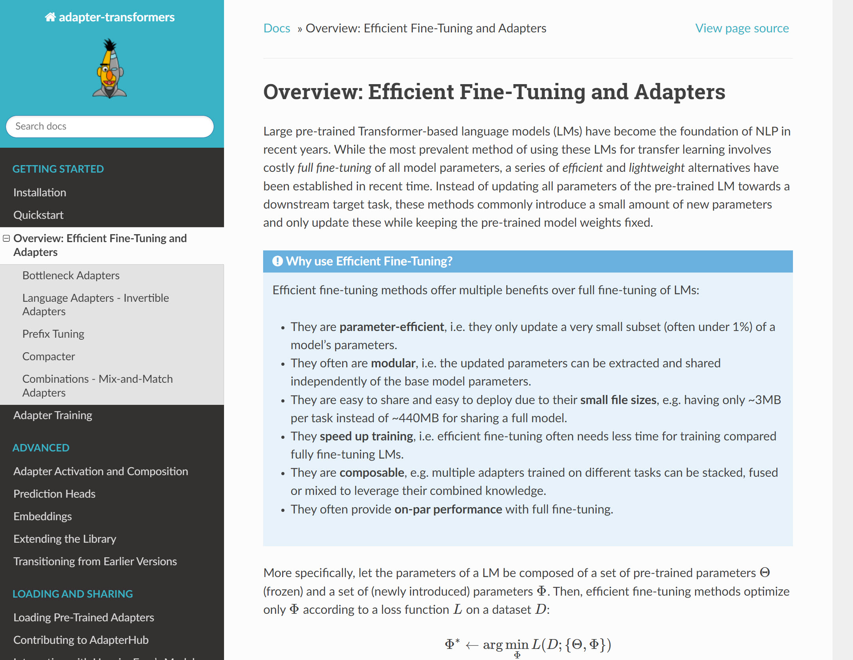
About adapters
Adapter-transformers
Adapter types
Efficient fine-tuning methods offer multiple benefits over full fine-tuning of LMs:
They are parameter-efficient, i.e. they only update a very small subset (often under 1%) of a model’s parameters.
They often are modular, i.e. the updated parameters can be extracted and shared independently of the base model parameters.
They are easy to share and easy to deploy due to their small file sizes, e.g. having only ~3MB per task instead of ~440MB for sharing a full model. They speed up training, i.e. efficient fine-tuning often needs less time for training compared fully fine-tuning LMs.
They are composable, e.g. multiple adapters trained on different tasks can be stacked, fused or mixed to leverage their combined knowledge.
More: https://docs.adapterhub.ml/overview.html

Slide 4
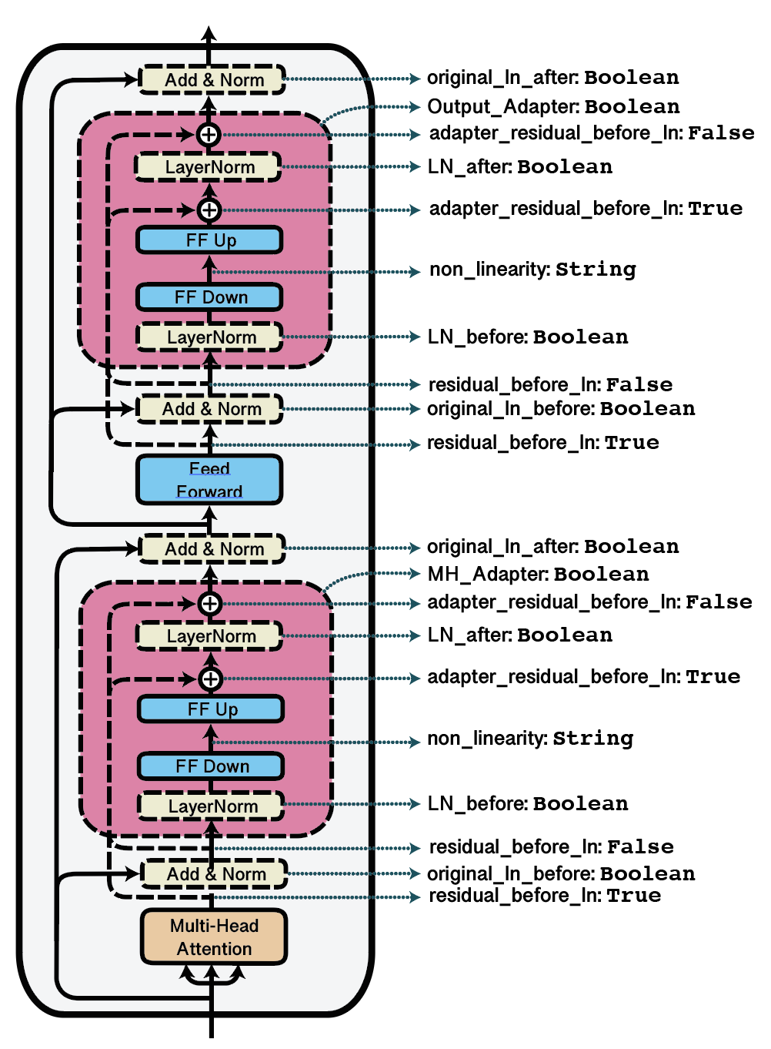
What is Adapters?
Bottleneck adapter scheme
Adapter types
Outline here: 1. Bottleneck
2. AdapterFusion
Others:
MAD-X, Invertible adapters
AdapterDrop
MAD-X 2.0, Embedding training
Prefix Tuning
LoRA
Parallel adapters,
Mix-and-Match adapters
Compacter
https://aclanthology.org/2021.eacl-main.39.pdf
Подробнее: https://github.com/adapter-hub/adapter-transformers#implemented-methods

Slide 5
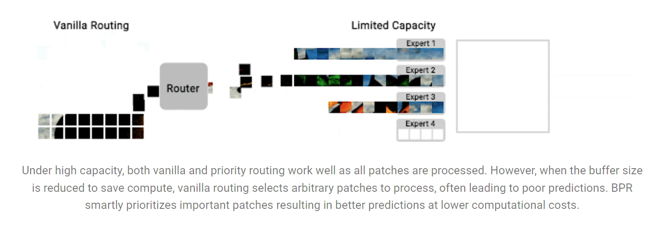
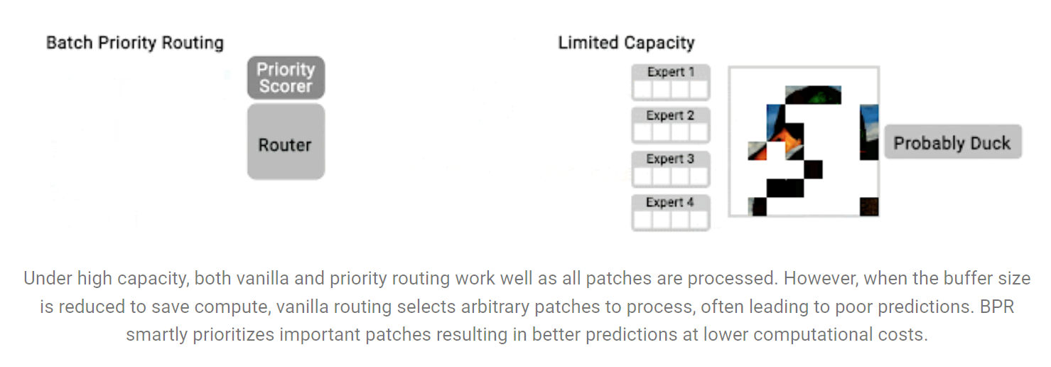
Разница FET и MoE
MoE from Google:
Mixsture of concepts
What is the concept behind: Bottleneck + MoE
There is a layer after LayerNorm layer or several layers of experts. At the output of the model, one or more probabilistic expert models are "attached". The probabilistic model allows you to learn faster
More: https://ai.googleblog.com/2022/01/scaling-vision-with-sparse-mixture-of.html

Slide 6
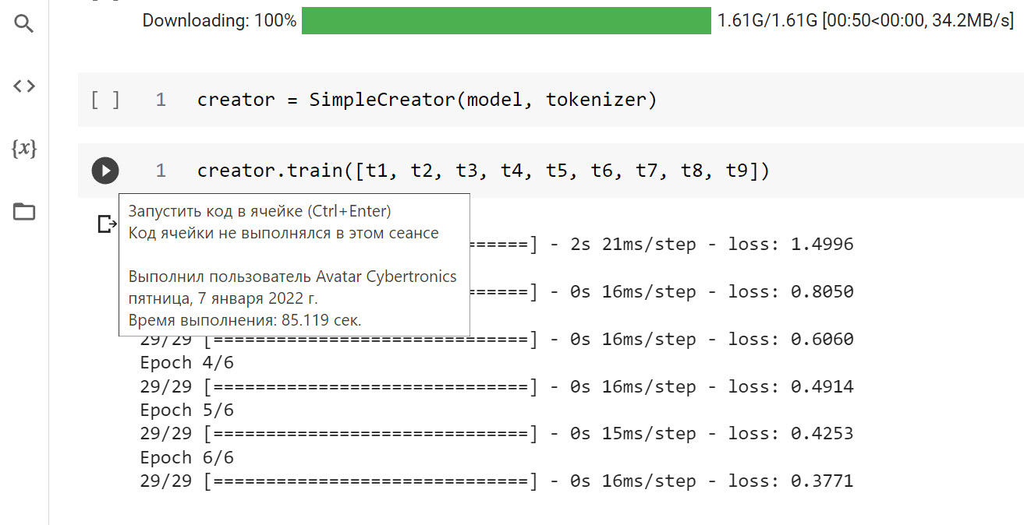
Fast Experts Tuning technology
FastExperts Tuning is 50+ times faster than fine-tuning
Training log (Training time on 1 GPU is 85 seconds), 6 epochs:
Task: Generating an article or replica on a given topic, so as not to train the entire neural network, because it is long and expensive
50-100 times faster than fine-tuning, for different models
50 times faster for the ruGPT3 medium model
How it works: instead of the full number of parameters, we train individual layers with a smaller number
GPU training is more than 2 times faster than CPU, on average
Training log (Training time on 1 CPU is 1 minute 22 seconds), 3 epochs:
Epoch 1/3 57/57 [==============================] - 22s 369ms/step - loss: 2.3544 Epoch 2/3 57/57 [==============================] - 22s 389ms/step - loss: 1.2231 Epoch 3/3 57/57 [==============================] - 21s 372ms/step - loss: 0.8616

Slide 7
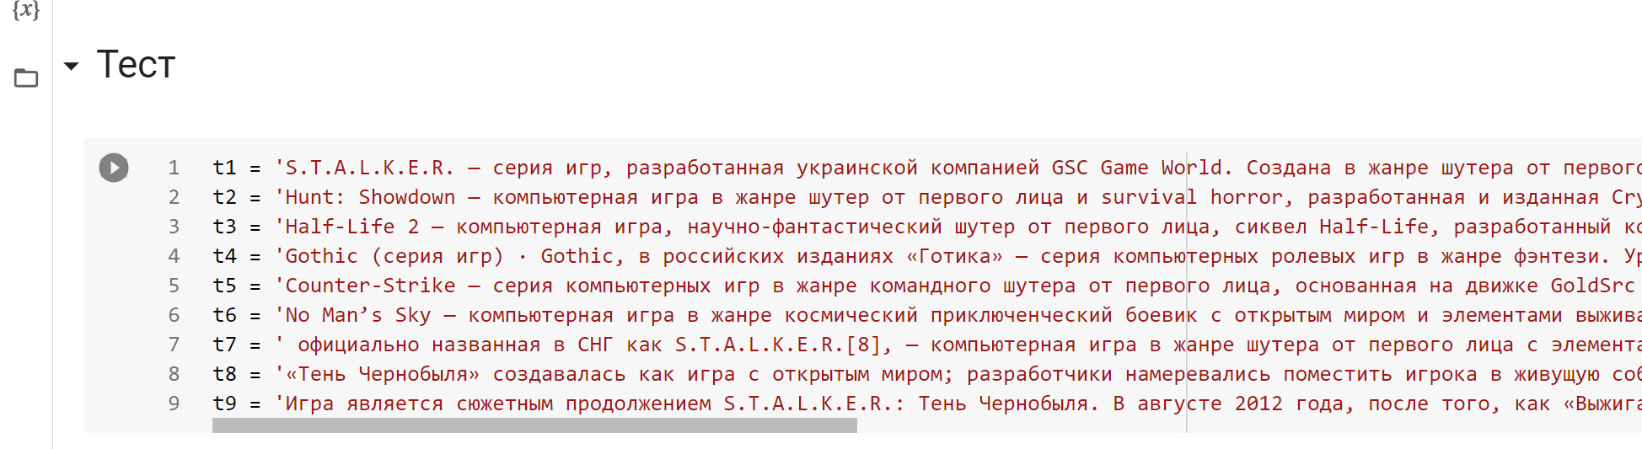
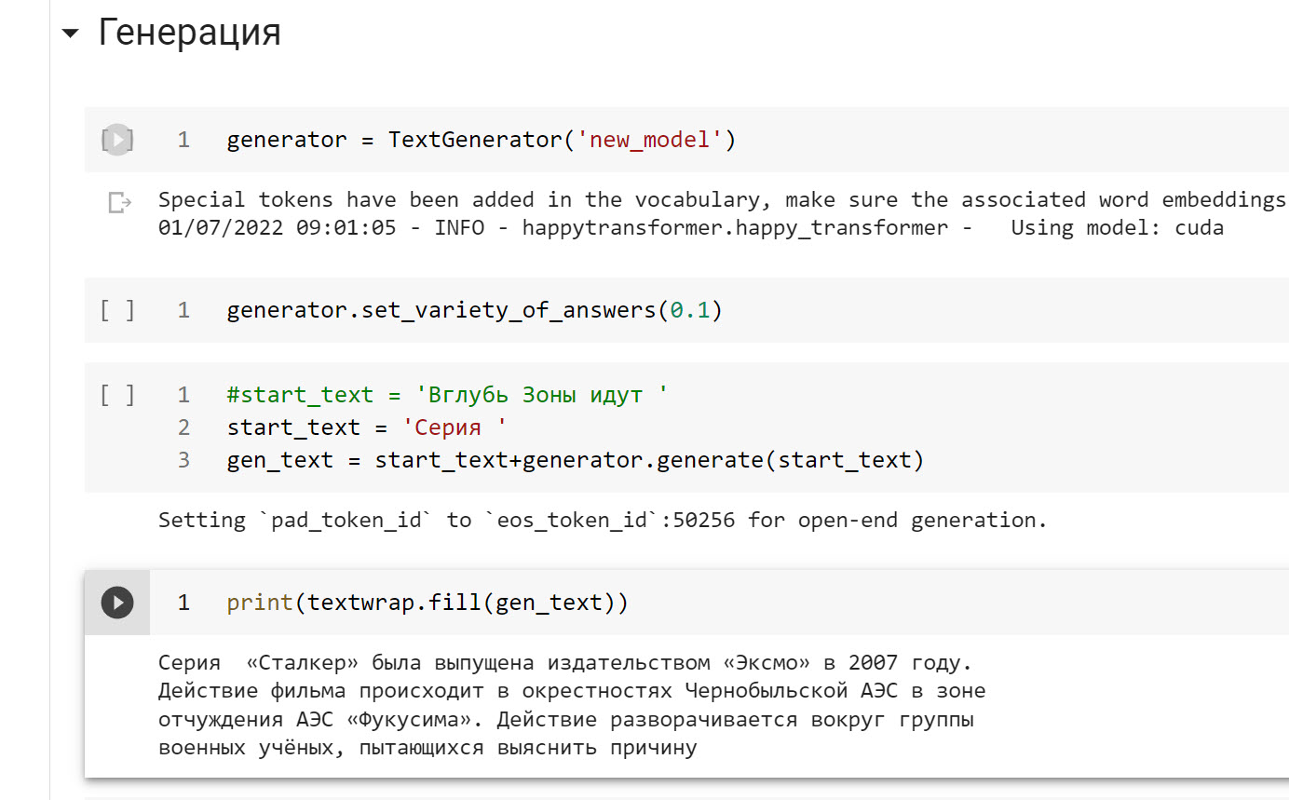
Fast Experts Tuning: generation results
Good controllable generation
Global task: Generation of continuation text, dialogue
There is a “set_variety_of_answers” parameter with a value from 0 to 1 that controls the variability. If it is equal to 0, then we follow the dataset, if 1 – almost the original model is used.
Before training (generation from the word "Stalker"):
Сталкер" - это сборник рассказов писателя Сергея Лукьяненко "Сталкер".
After training (generation from the word "Stalker"):
Сталкер — игра с открытым миром Result: we got controllable generation

Slide 8
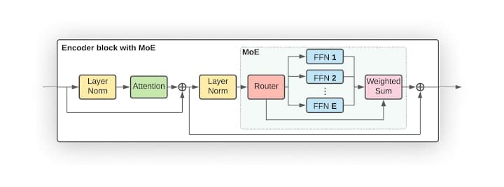
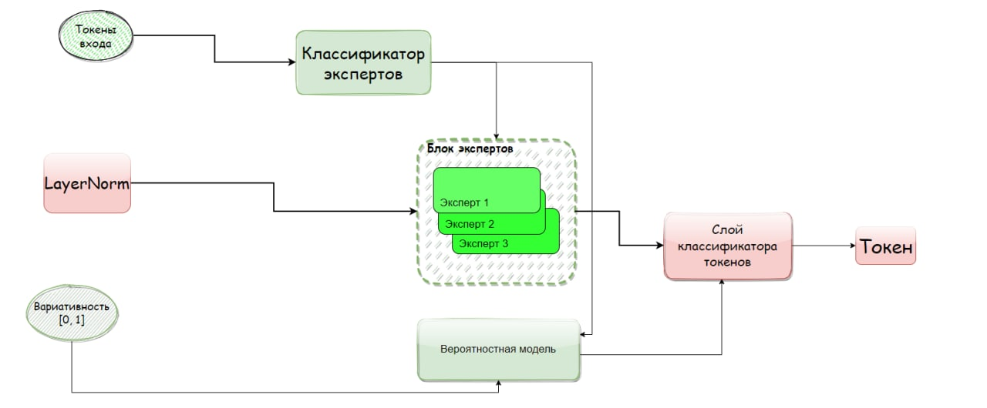
Fast Experts Tuning vs MoE
FET vs MOE
Task: To speed up controllable generation, but leave the quality of the generated text at the same level
An additional model that helps Experts
There is no Weighted Sum block, but there is an effect of it
LayerNorm – from GPT
The idea is similar to Google's MoE, but the implementation is more efficient

Slide 9
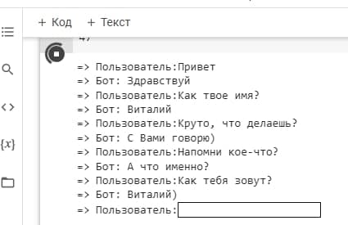
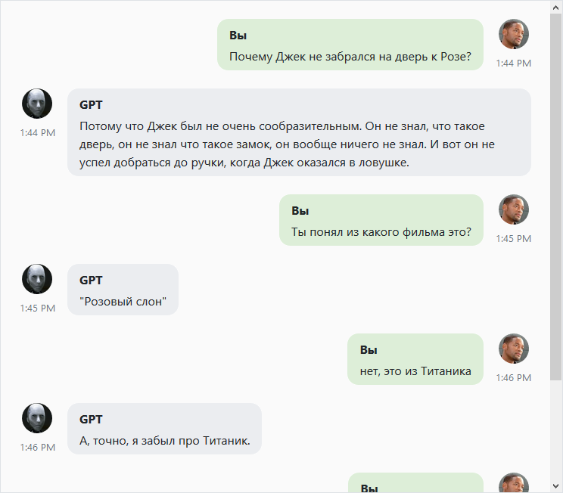
Fast Experts Tuning and other methods
Effect of FET
Local task: Generation control. Obscene expressions disappear, he begins to understand his name. Fast, useful for product hypotheses
Model: rudialogpt3_medium_based_on_gpt2
Generation of coherent, coherent text
Neural networks trained by this method do not adapt well to new global tasks, for example, it is possible to make a dialog model from a summarizer, but the quality will be worse. (Work in progress: we know how to solve this problem)
However, this is often not required, because as a rule it is required to train a neural network already for the final task

Slide 10
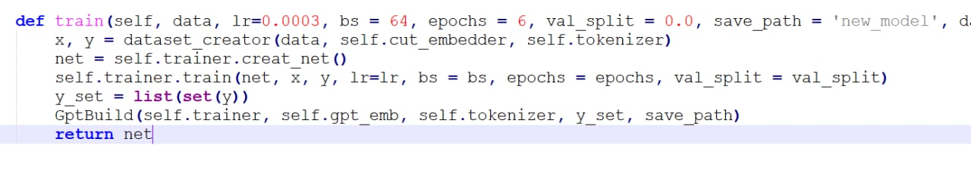
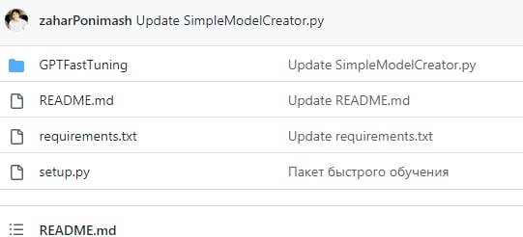
GPTFastTuning Library
GPTFastTuning
The library implements the FET learning algorithm
Github available (private)
Demo on Google Colab
Modular and efficient

Slide 11
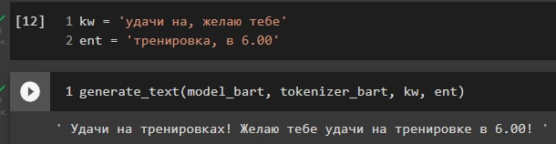
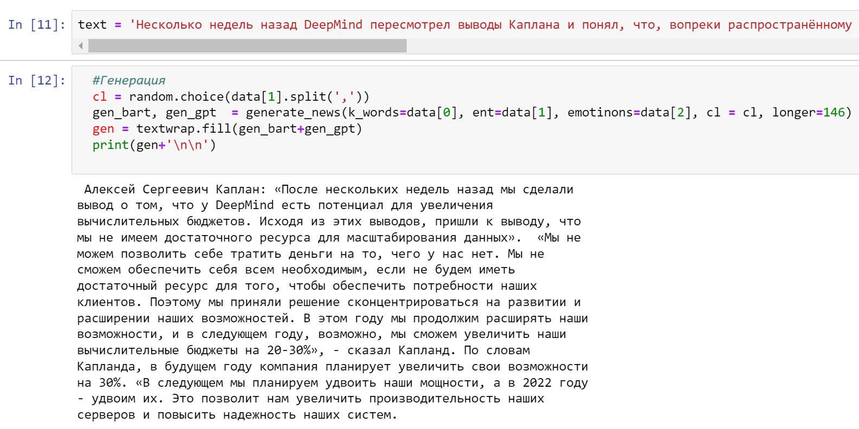
Interpretable generation with BART
BART control
The library implements the FET learning algorithm
BART generation use entities (common NERs) and make coherent text from them
The quality of generated text is better than GPT

Slide 12
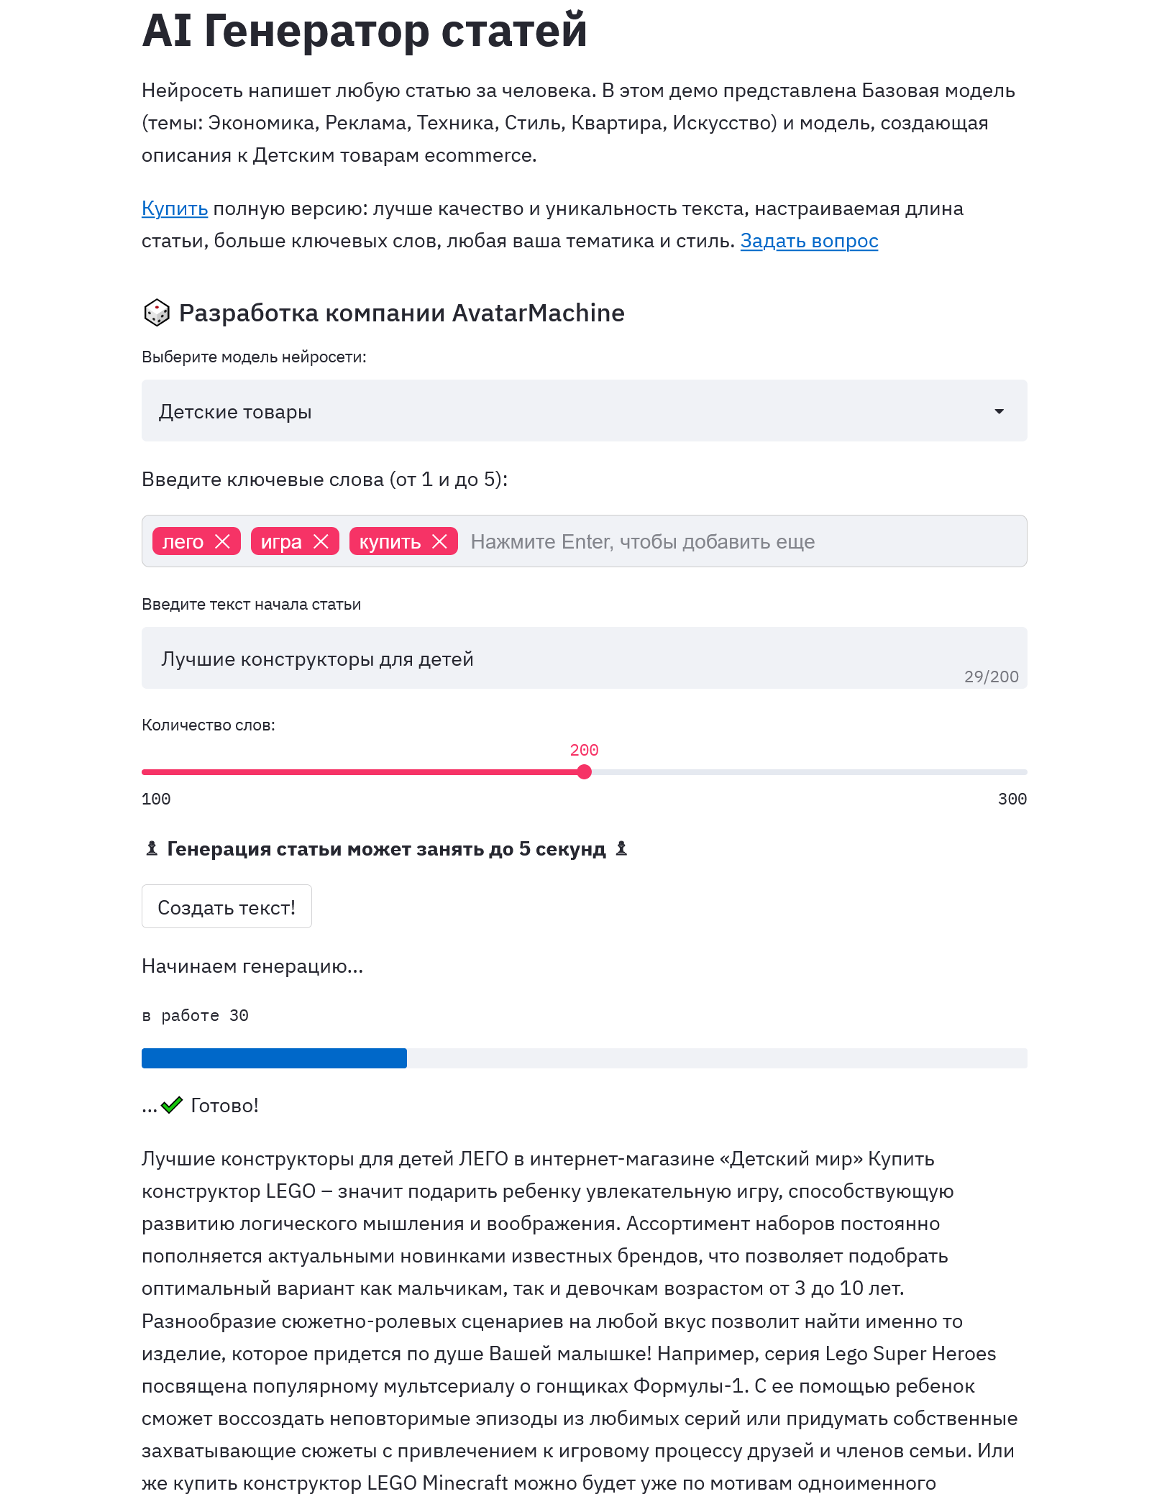
Interpretable generation with GPT
GPTFastTuning
ruGPT3 generation use keywords and make coherent text from them.

Slide 13
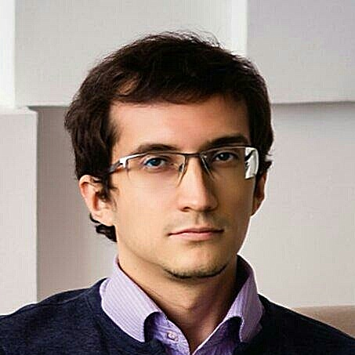

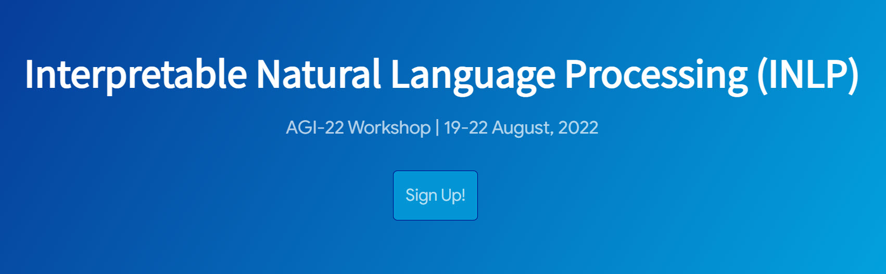
Contacts
Ai visionary, Newton chatbot developer
ceo@graphgrail.com
http://graphgrail.com/ru
6 years of experience in AI. Author of his own Ai Framework
https://github.com/AIFramework/AI_Free
Victor Nosko
Zachar Ponimash
CEO, Ai researcher
CTO, Ai researcher

